Slide 1

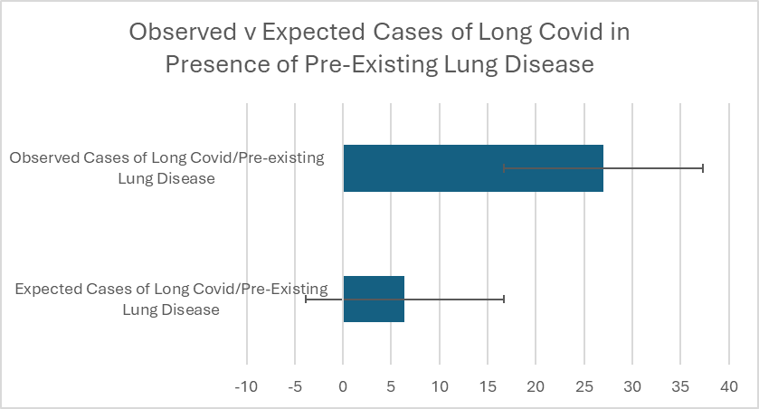
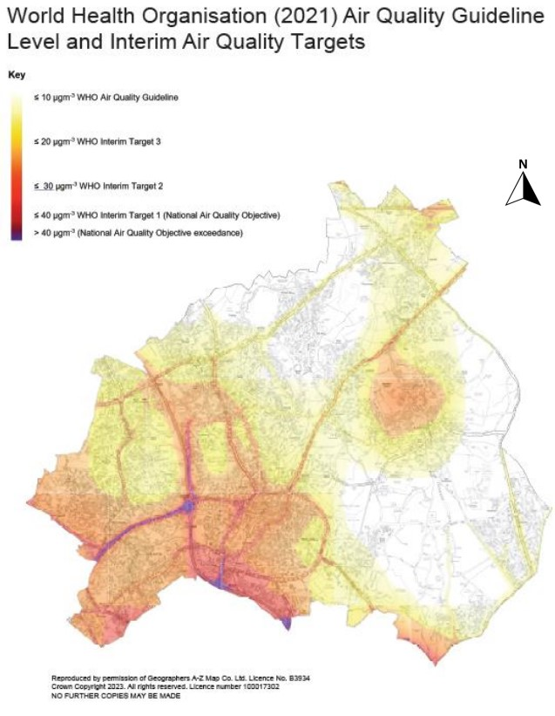
Pre-existing chronic respiratory disease is a significant risk factor for long covid: A Retrospective Study of referrals to Walsall Long Covid Clinic.
02
Cahill E¹, Ellison A¹, Clifford D¹, Norgaard S¹, Kalansooriya A², Hartland AJ¹
¹Walsall Long Covid Service, Walsall Healthcare NHS Trust
²Black Country Pathology Services, Royal Wolverhampton Hospitals NHS Trust
Background
Results
Respiratory symptoms are common in long covid, but any association between pre-existing chronic respiratory disease and subsequent long covid remains a topic of investigation.
A total to 297 new patients were seen by WLCC during the study period. All patients fulfilled CDC criteria for long covid. Thirty-one (31) patients had documented pre-existing chronic respiratory disease at time of contracting covid-19. Using prevalence data for chronic respiratory disease in Walsall, the expected number of patients was 7.4 (p<0.01).
Aims
We investigated the association between pre-existing chronic respiratory disease and the incidence of long covid in Walsall, West Midlands.
Material and Methods
We conducted a retrospective audit of new patients seen in the Walsall Long Covid Clinic (WLCC) between 1st January 2023 and 31st December 2023 (12-month study period).
For all patients, a diagnosis of long covid was confirmed using CDC Criteria.
At initial consultation, a full clinical history was recorded including past and current medical conditions.
A retrospective audit of all case notes was conducted to determine the number of patients with pre-existing chronic respiratory disease (Chronic obstructive pulmonary disease/asthma) within this study group.
This was compared with the expected number, obtained using Office of National Statistics data for the prevalence of chronic respiratory disease in Walsall
Conclusion
The prevalence of pre-existing chronic respiratory disease was approximately 5-fold higher in patients referred to WLCC with long covid than expected based on overall population prevalence of chronic respiratory disease.
Pre-existing chronic respiratory disease is a risk factor for long covid.
Reference:
Walsall Public Health Insight Report. Walsall Public Health Insight Report, Public Health Walsall, HMSO, 2023

