Slide 1

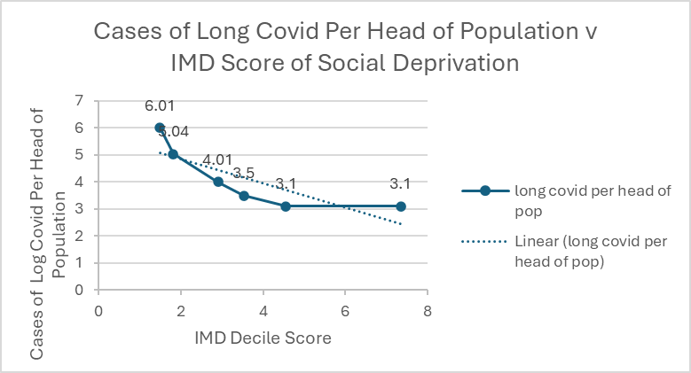
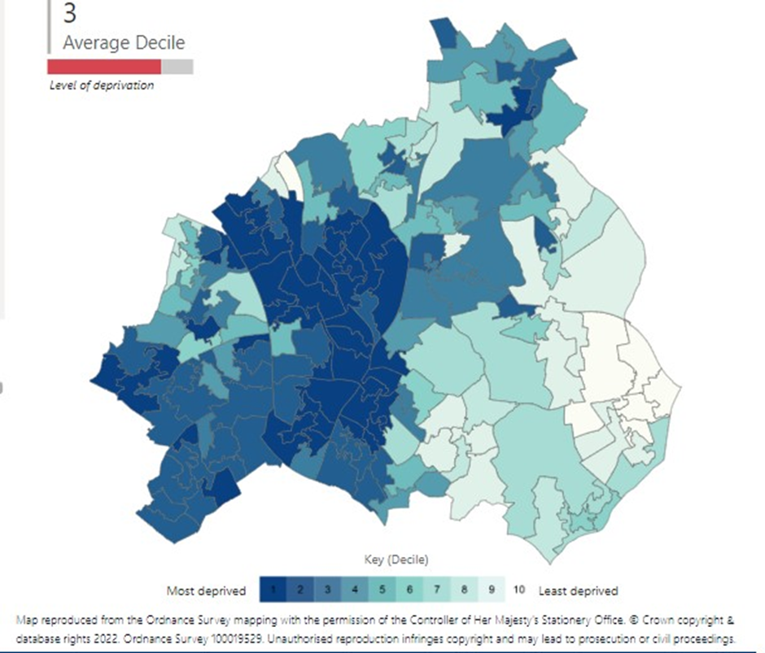
Social deprivation is a risk factor for long covid: a retrospective study of long covid in Walsall, UK
.
03
Ellison A¹, Cahill E¹, Clifford D¹, Norgaard S¹, Hartland GMR², Kalansooriya A², Hartland V¹, Inthujah T², Hartland AJ²
1-Walsall Long Covid Service, Walsall Healthcare NHS Trust
2-Black Country Pathology Services, Royal Wolverhampton Hospitals NHS Trust
Background
Results
Walsall, UK, total population of approximately 250 000, comprises 6 Urban Areas (UAs) made up of 167 LSOAs (lower level super output areas).
The 2 most deprived UAs contain 44 neighbourhoods among the most socially deprived 10% in England (Office of National Statistics -ONS data) with Index of Multiple Deprivation (IMD) decile scores significantly lower than the borough’s least deprived (1.48 v 7.34 , p<0.01).
Previous studies have suggested an association between social deprivation and incidence of long covid, although findings were inconclusive.
The IMDS between the most and least deprived UAs were statistically significantly different (1.48 v 7.34, p <0.01)
In the study period 11 586 cases of long covid were identified in a total population of 284 114.
The incidence of long covid was significantly greater in the most socially deprived UA than in the least socially deprived UA (9.09 v 3.10 per 100, p <0.01). Regression analysis comparing IMD and incidence of long covid showed a strong correlation (r =-0.82, Spearman’s correlation coefficient)
Aims
To investigate whether social deprivation is associated with the incidence of long covid in Walsall, UK.
Material and Methods
A retrospectively study of data 1st January 2021 – 31st December 2021 was conducted.
From Public Health England, Public Health Walsall, Quality and Outcomes Framework (QOF) data and the 2021 census, the population and incidence of long covid per UA was determined and compared.
Conclusion
The incidence of long covid is associated with increasing social deprivation in Walsall, UK.
Reference:
Wachtler B, Michalski N, Nowossadeck E, Diercke M, Wahrendorf M, Santos-Hövener C, Lampert T, Hoebel J. Socioeconomic inequalities and COVID-19 - A review of the current international literature. J Health Monit. 2020 Oct 9;5(Suppl 7):3-17. doi: 10.25646/7059. PMID: 35146298; PMCID: PMC8734114

